Slide 1
https://youtu.be/7cF9nIf0qvQ

Slide 2
Introduction to Organic Denmark
- Leading organic food cluster in Denmark
Organic Denmark has brought together the entire organic sector in Denmark comprising of 215 companies and 941 organic farmers
941
Organic farmers
2.216
Consumers
215
Companies
102
Kitchens/
Food Service
Non-profit organisation with 4 member types

Slide 3
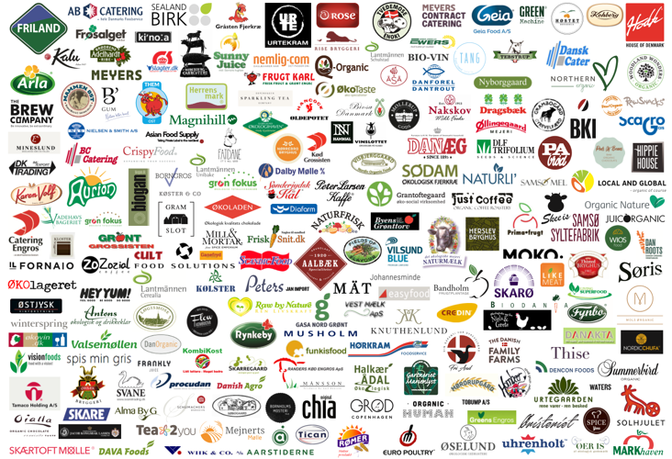
Introduction to Organic Denmark
- Leading organic food cluster in DK with 215 member companies

Slide 4


Two golden triangels of developing organics in Denmark
Government
Organic Companies
Organic Denmark
Retailers
Source: Organic Denmark 2016

Slide 5

Facts about Denmark
- Organic history
1981: First organic rules in Denmark
1987: First Danish organic legislations in 1987 (the World’s first)
Since 1987: Governmental control of organic products in DK
1991: First organic EU regulations (only vegetable products)
2000: Common organic EU regulations (vegetable & animal)
Today:
Denmark is considered a pioneer nation in the global market for
organic agriculture, in terms of both production, consumption and
exports.
More than 25 years’ experience in paving the way for organic growth.

Slide 6
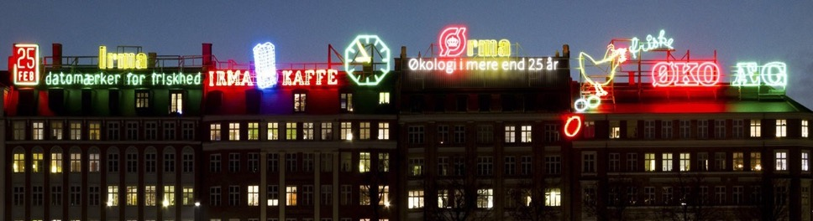
Celebrating the 25th anniversary of ”Ø-brand”
Irma decided to replace the “I” in Irma, with the Ø-brand. To emphasise their organic profile. It stayed there in whole 2015.

Slide 7
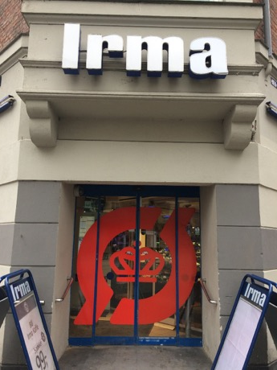
VISIBILITY:
The entrance tells it all …

Slide 8
Organic market share in retail supermarkets
11%
%
Kilde: GfK og Danmarks Statistik

Slide 9
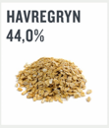
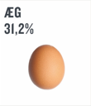
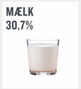
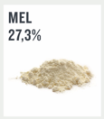
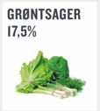
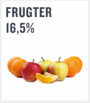
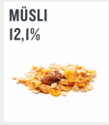
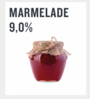
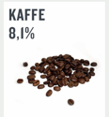
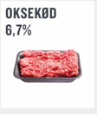
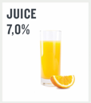
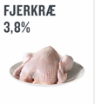
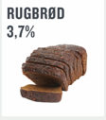
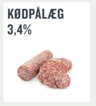
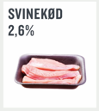
Organic market share for selected products
High
Market share
Moderate
Market share
Lower
Market share

Slide 10
Retail share of the organic market
%

Slide 11
Retailers competing on organic performance
Vedligehold kategorifokus
Vækstkategorier
Utilisation of organic potential
Evaluer kategorifokus
Udviklingspotentiale
How focused are the customers on organic
Notes:
The overall potential and performance of the supermarkets
”Føtex” and ”Meny” have an unutilised potential for sale of more organic food to the customers

Slide 12
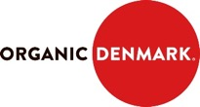

Retail share of the organic market
Inspiration
Collaboration: Top management, each chain
Assortment
strategies
Product
presentations
Advertising, in-store info, PR.
Central
purchase & logistics
Producers
Chain stores
Consumers
Notes:
The most unique factor contributing to the growth of the organic market is the very close collaboration between Organic Denmark and each supermarket chain. The whole goal is to make organic succes easy for them
Producers organization organic Denmark, creates tailormade strategies for the individual supermarket chains.
…..so the government is not just financing campagnes, but the capacity to motivate broadly in the market.
At the same time the government has demanded that Denmarks many agri-funds (such as Dairy Boards etc that collect funds from farmers and reinvest in research, advisory services and market development) also invest in the organic sector. These funds are allowed, by law, to tax farmers—also organic farmers, so its only fair ☺

Slide 13


With 29,1% of the turnover coming from organic products Irma is a clear market leader in terms of offering a broad and inspiring organic assortment
Irma
Owner | COOP
Stores | 80
Organic market share
Organic share of total turnover in the food category
Organic products in assortment
Key words | Lead retailer, high-quality products, firstmovers, innotative

Slide 14

The ‘Irmas shoppers’ buy much more organic products compared to the average Danish shoppers and Irma is very good at utilising their organic potential

Slide 15

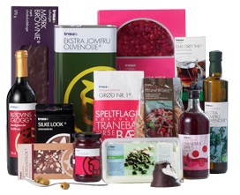
Irma has app. 1100 organic products in their assortment. The OL brand ‘Irmas økologisk balance’ counts products both in the value and the volume position

Slide 16
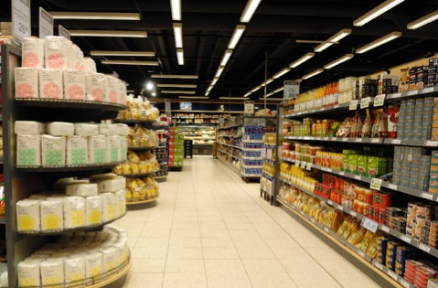
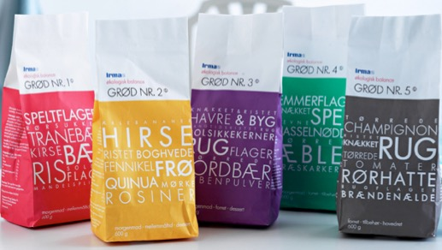
Irma is outperforming other Danish retailers in introducing new trendy organic products eg. 6-8 different porridge variants from Aurion, as well as testing new instore placement of organic products, eg. Organic flour from Skærtoft mølle placed on an end-shelf

Slide 17
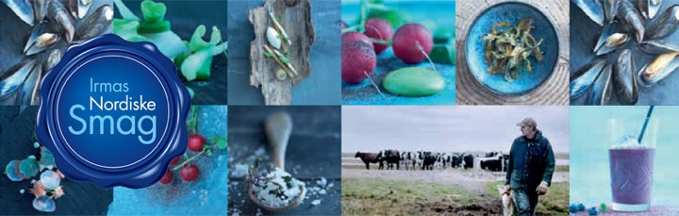
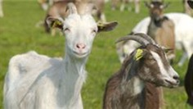
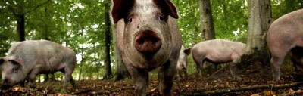
Irma coorporates with several smaller producers, who can offer clear differentiated products with a good product story and deliver products to the concept ”Irmas nordiske smag”, eg. Goat meat from ‘Stenalt Gods’ or meat from pigs living in the woods

Slide 18
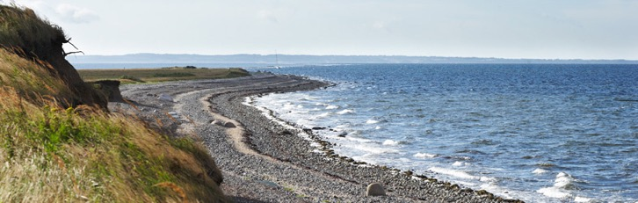
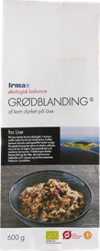
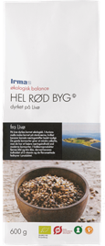
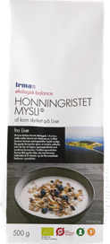
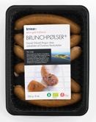
As one of the latest initiatives on the ‘diferentiation ladder’ Irma has ”adopted” the small island Livø and developed unique organic concepts only available in the Irma stores

Slide 19

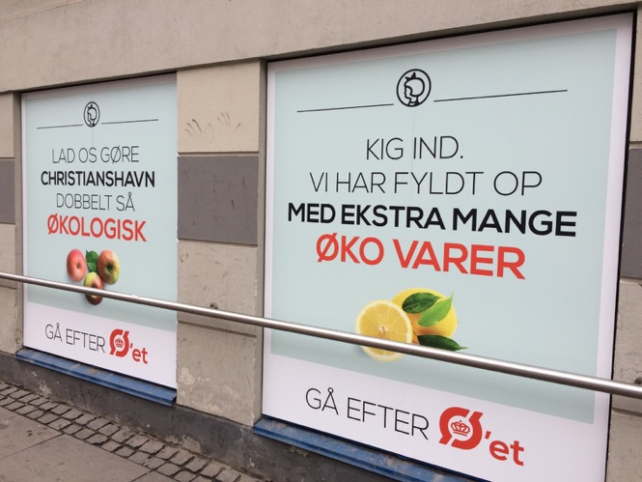
Visibility
Notes:
Index 328 in 6 years!!!!!!

Slide 20

Netto has the market leader position in the discount sector and the highest share of total sales (value) of organic products in Denmark
Netto
Owner | Dansk Supermarked
Stores | 430
Organic market share | 16,3%
Organic share of tot. turnover food | 10,3%
Organic products in assortment | App. 150
Key words | Market leader, provocative, lots of attitude, innovative, high-quality products at discount prices
Notes:
Index 328 in 6 years!!!!!!

Slide 21
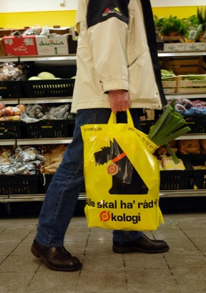
With more than 400 stores and only app. 100 organic products in their assortment. Besides that Netto often offer
organic products
as spot deal

Slide 22
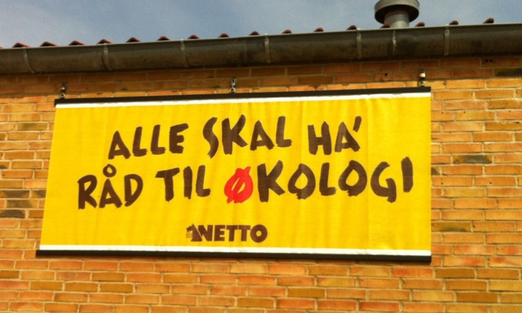
With the message ‘ everyone should be able to buy organic’ is Netto communicating the organic offer as an important part of ‘the Netto profile’. Netto was first mover among discounters in terms of profiling the organic offers

Slide 23
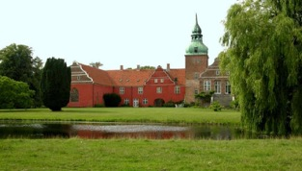
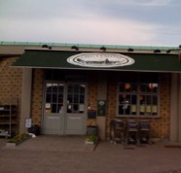
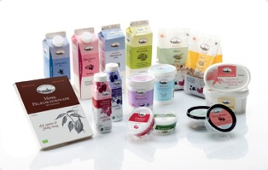
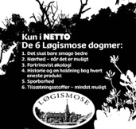
2010 Netto made a closer partnership with Løgismose and launced a the concept ‘Løgismose – selected’. Løgismose is well-known for it’s high-quality products - especially cheese & oysters.

Slide 24
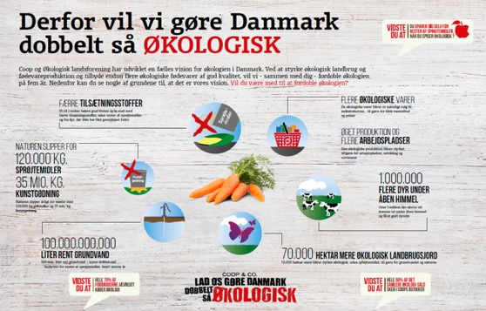
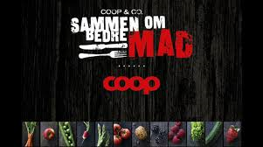
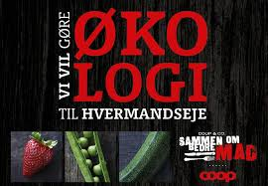
COOP DK
Kilde: Danmarks Statistik 2015
Notes:
Index 328 in 6 years!!!!!!

Slide 25
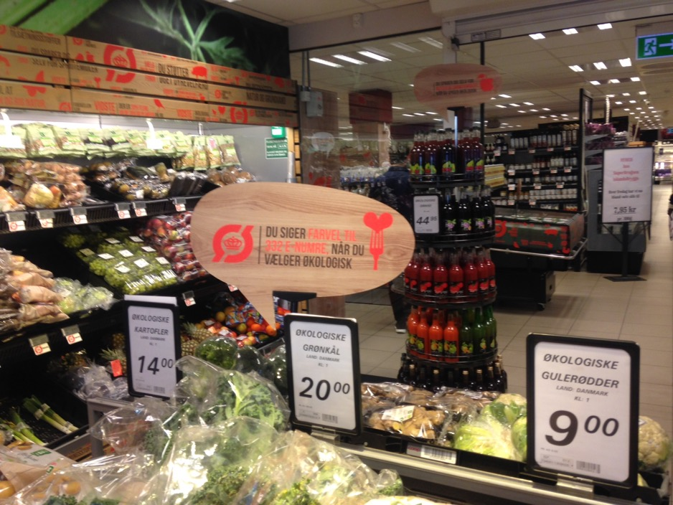
Notes:
Index 328 in 6 years!!!!!!

Slide 26
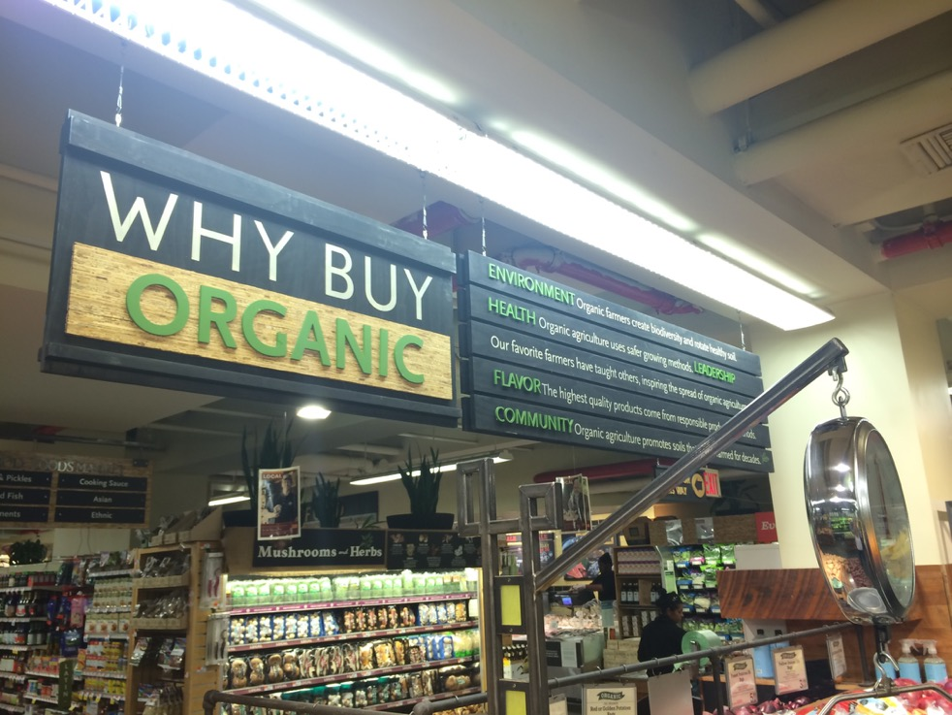
Økologiske budskaber

Slide 27
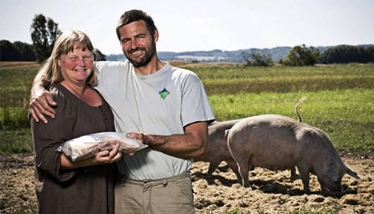
Bringing the farmer closer to the customer
WHO
WHERE
HOW
WHY
about organic products!

Slide 28

Consumers RTB for buying Organic
REASON TO BELIEVE:
✓ Certified organic products :
100% free from pesticides
Cows/Animals on grass during summer
100% organic feed
No use of ‘gødning’
No GMO
30% more animal life
30% more plants on organic fields
An increased organic area

Slide 29
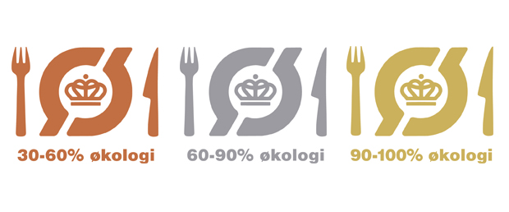
Organic Label in professional kitchens
Notes:
The Organic Cuisine Label enables public kitchens and restaurants to brand themselves according to the percentage of organic products.
Today, more than 2,350 eateries display the Organic Cuisine Label

Slide 30
Organic sales in Food Service (DK)

Slide 31
Danish organic export
Kilde: Danmarks Statistik 2015
Notes:
In recent years, Danish organic export has experienced a huge increase and in just one year the export of Danish organics has increased with 23 %. The positive development is expected to continue in the future and Organic Denmark estimates that the Danish organic export will increase minimum at a level of + 15% year on year.

Slide 32
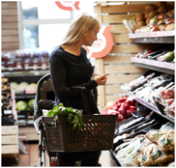
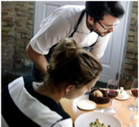
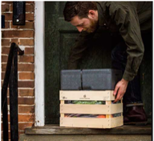
Expected growth 2017
14%
25%
30%
Supermarkets
Food service
Online sales

Slide 33
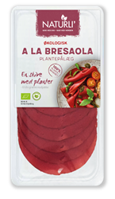
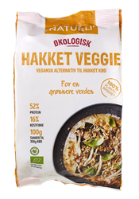
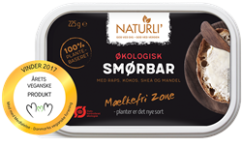
Future Food trends
Flexican Food: Power to the plants

Slide 34



Future Food trends
Think Twice: From trash to treasure

Slide 35



Future Food trends
Clean Eating: The purer the better

Slide 36



Future Food trends
Hood Food: Closer to mindfuld

Slide 37



Future Food trends
Medicine Food: Good for you

Slide 38

Future Food trends
Cool Classic: My favorite food

Slide 39



Future Food trends
Snackifikation: The new meal

Slide 40



Future Food trends
Dogma Food: Breaking rules

Slide 41



Future Food trends
Helping Hand: Real food fast

Slide 42



Future Food trends
Gastro Moments: A little luxury

Slide 43



Future Food trends
Morganic: Democratic health

Slide 44



Future Food trends
Some Eating: Food gone viral

Slide 45

Thank you for listening
Contact information
Pernille Bundgård
International Market Director
pbs@okologi.dk
www.organicdenmark.com

